Slide 1
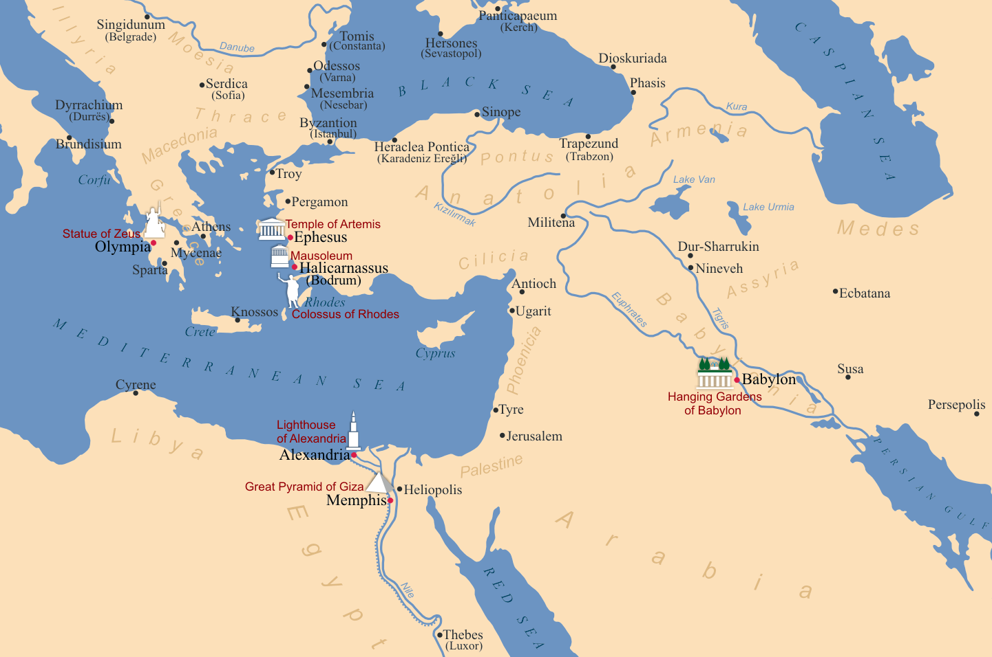
Notes:
Artist: Kandi
https://en.wikipedia.org/wiki/Seven_Wonders_of_the_Ancient_World#/media/File:Seven_Wonders_of_the_Ancient_World.png

Slide 2
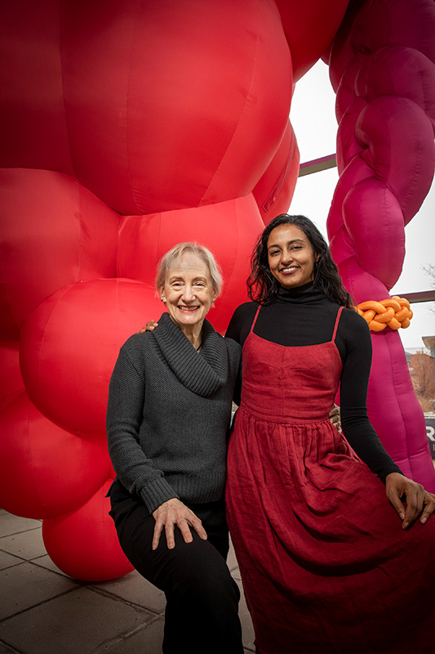
Nancy Davidson (L) Lakshmi Ramgopal (R)
Notes:
Photographer: Fred Zwicky
https://news.illinois.edu/view/6367/805551#image-2

Slide 3
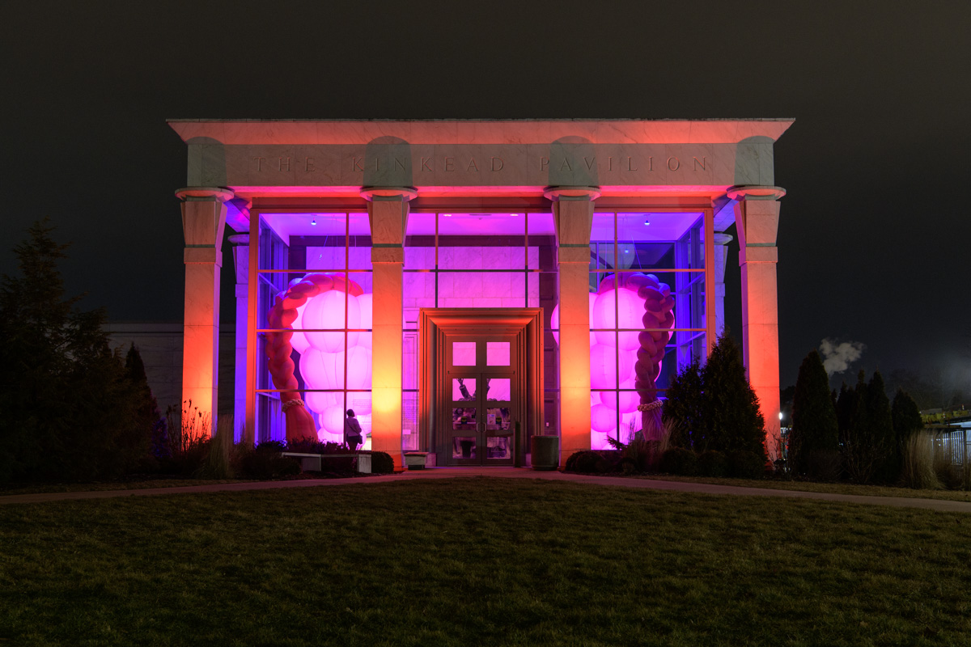
Notes:
Photographer: Della Perone

Slide 4
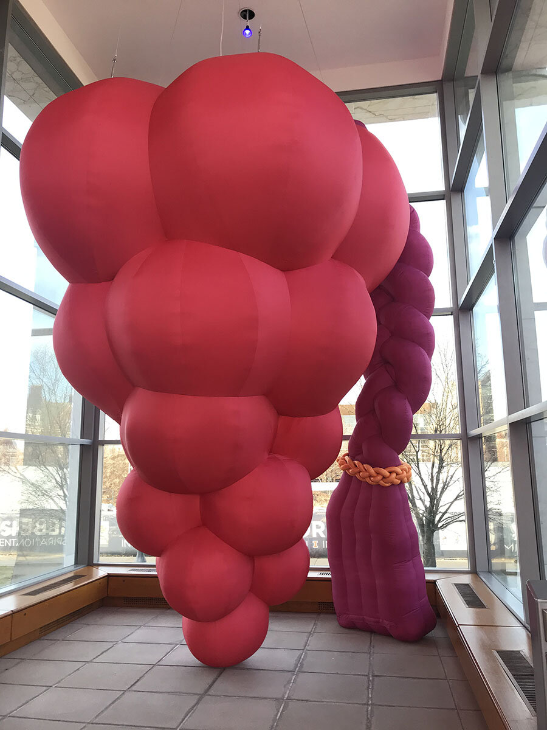
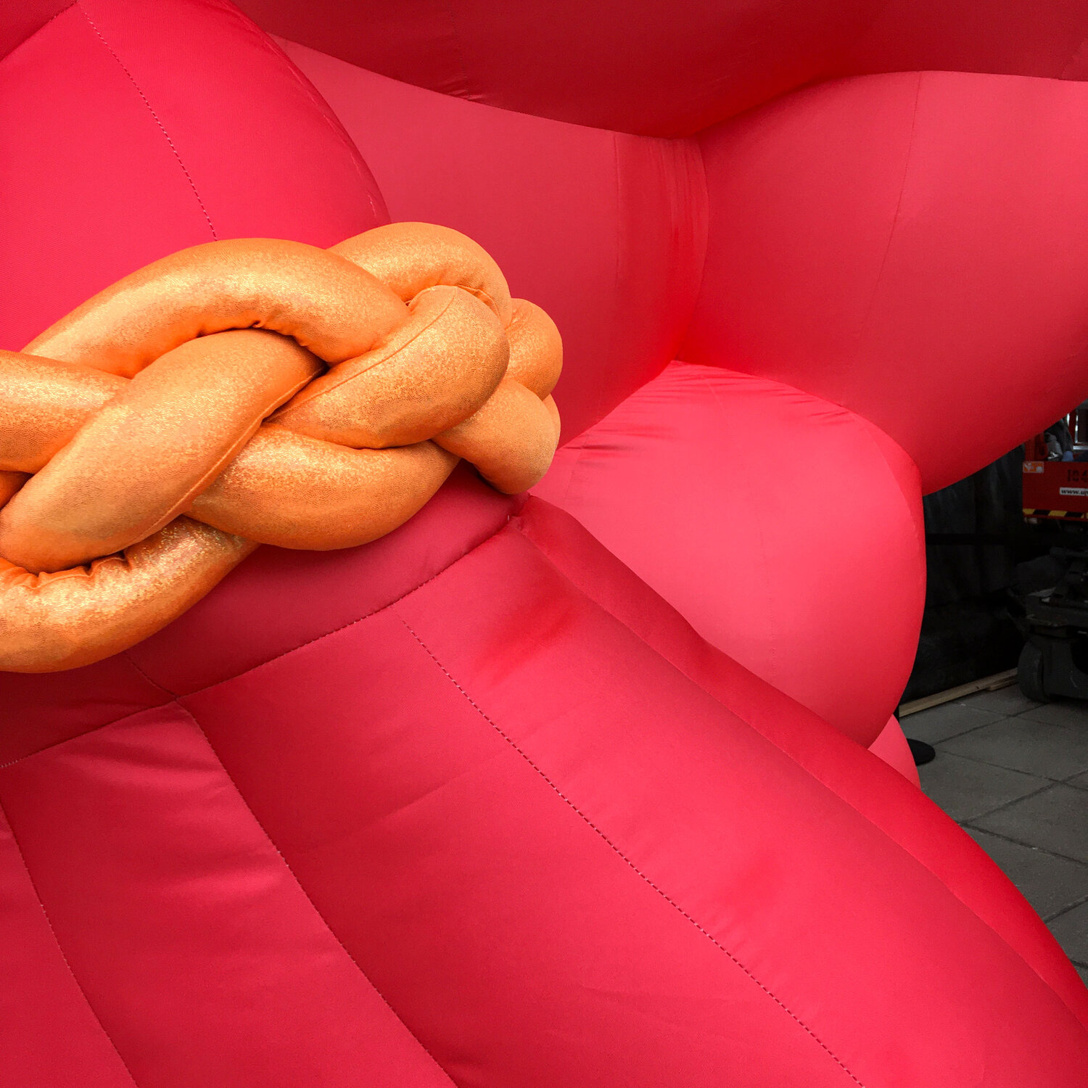
Notes:
Photographer: Mary McGrath
http://www.nancydavidson.com/
Photographer: Nancy Davidson
http://www.nancydavidson.com/

Slide 5
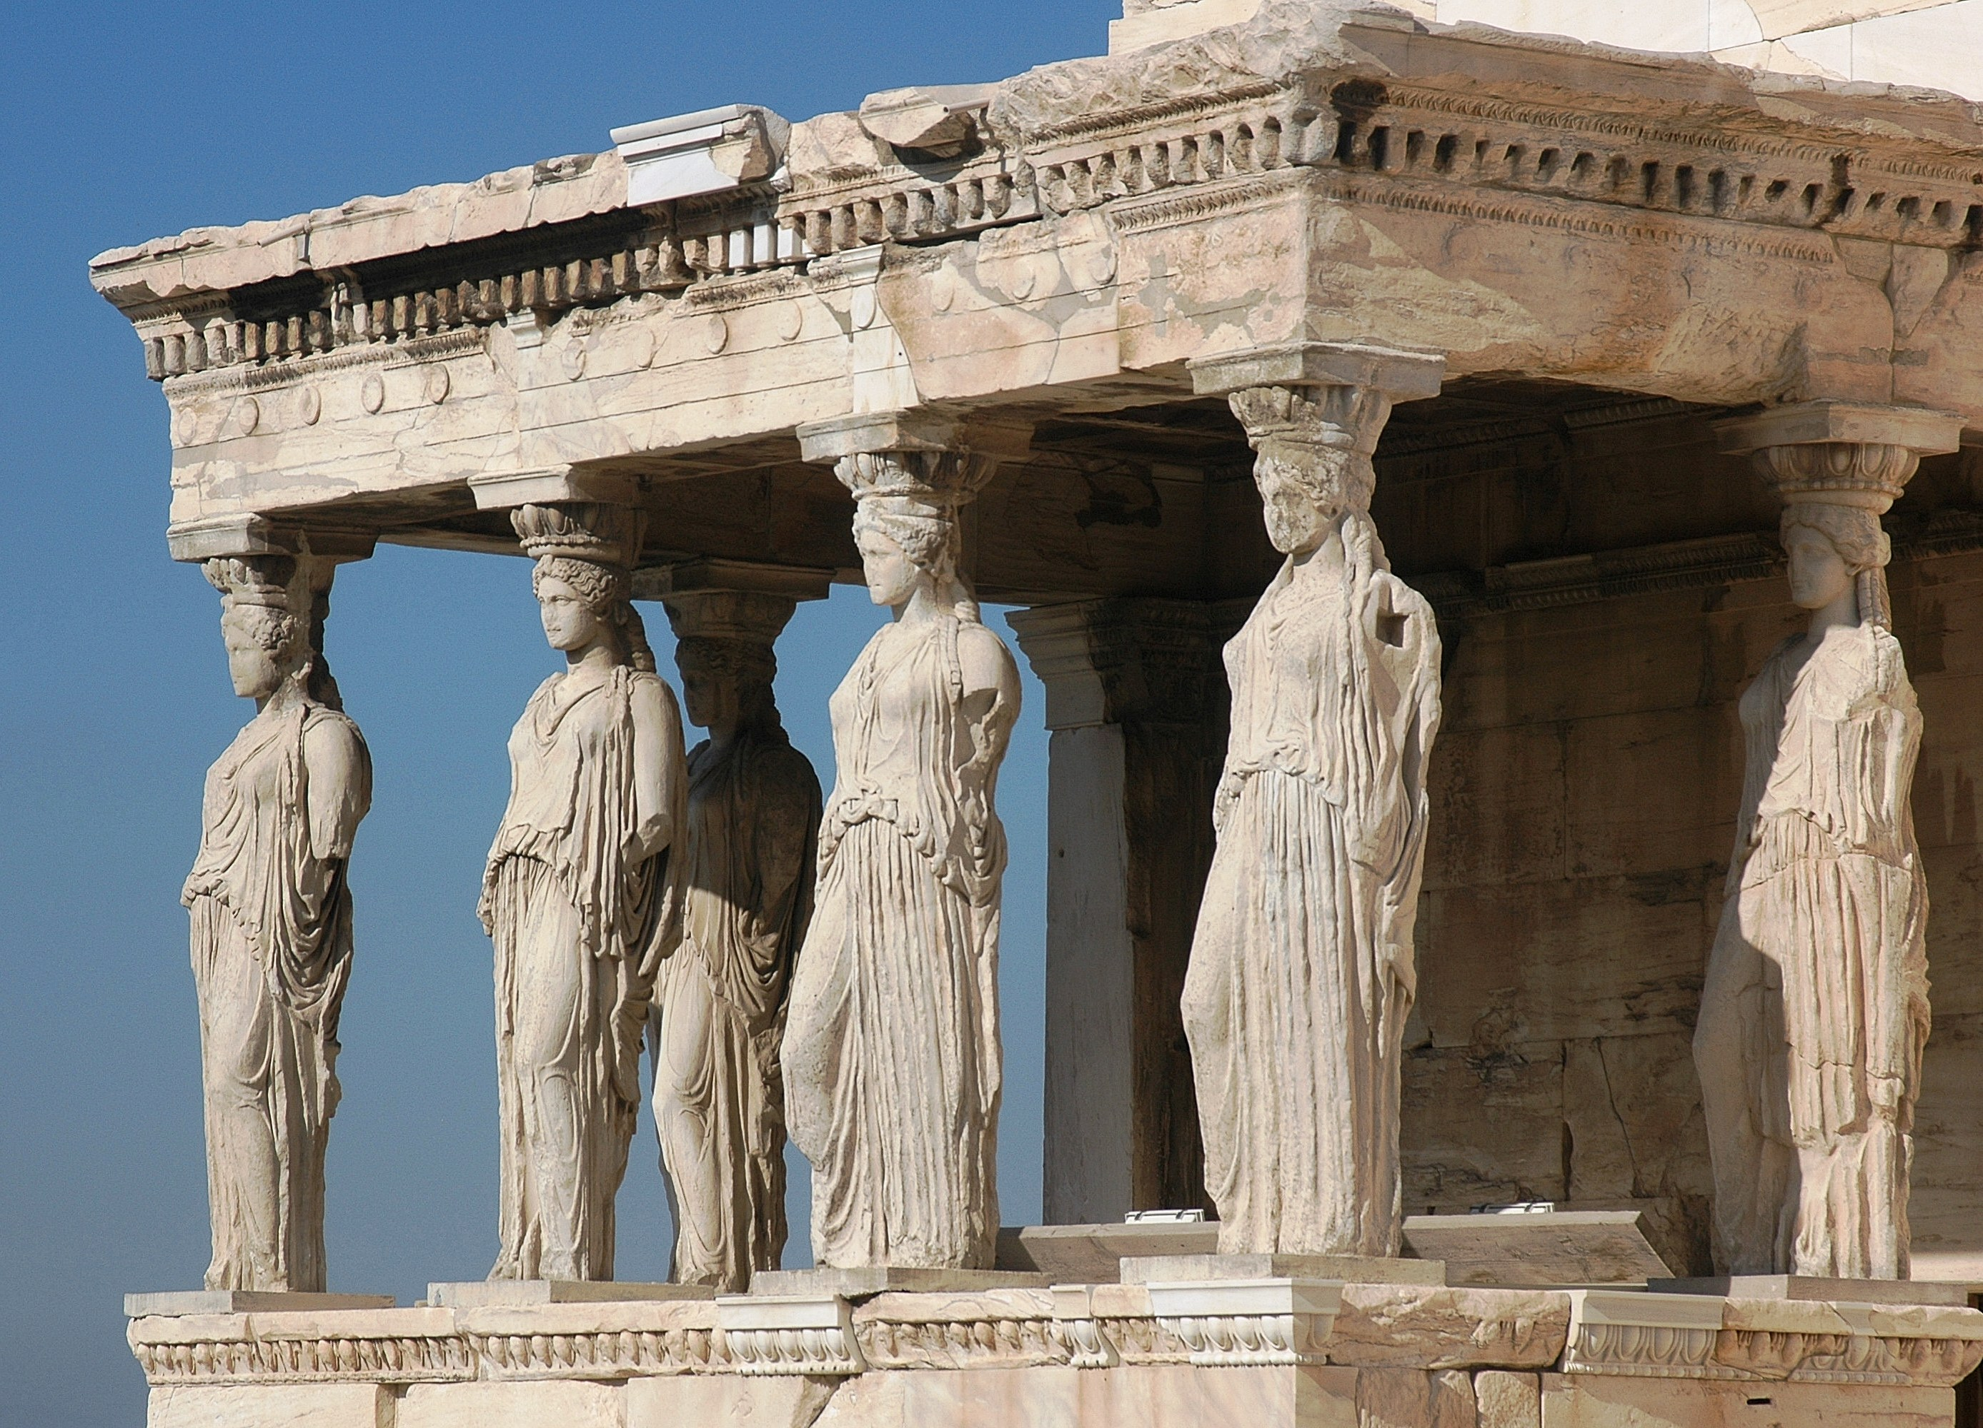
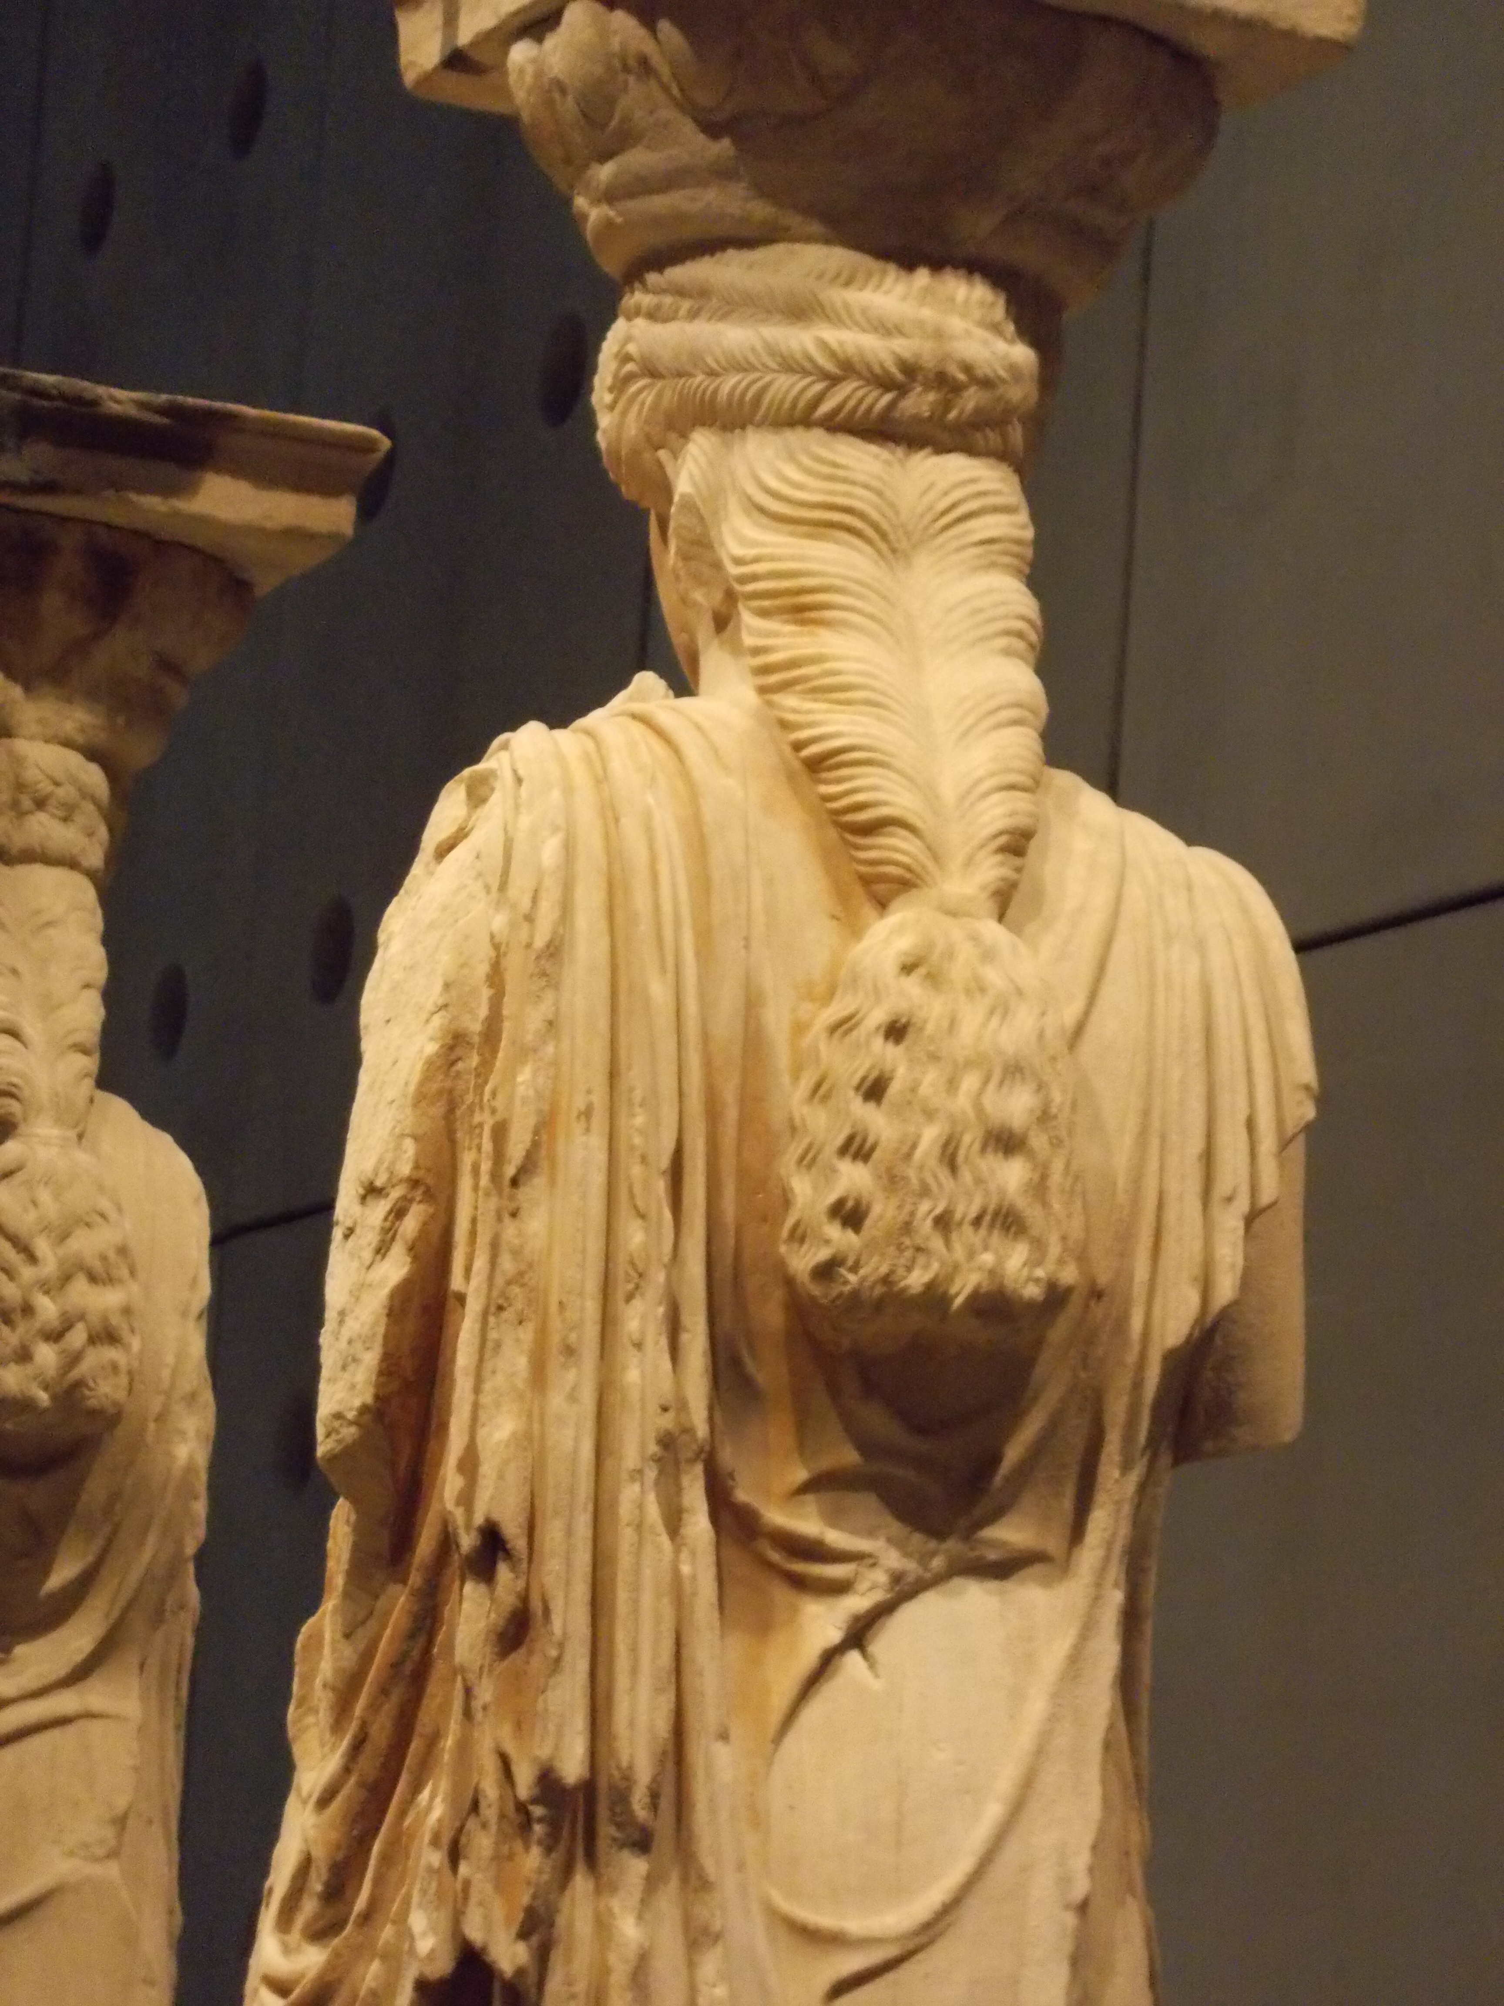
Notes:
Photographer: Harrieta171
https://en.wikipedia.org/wiki/Caryatid#/media/File:Ath%C3%A8nes_Acropole_Caryatides.JPG
Photographer: Odysses
https://commons.wikimedia.org/wiki/File:Caryatid.jpg

Slide 6
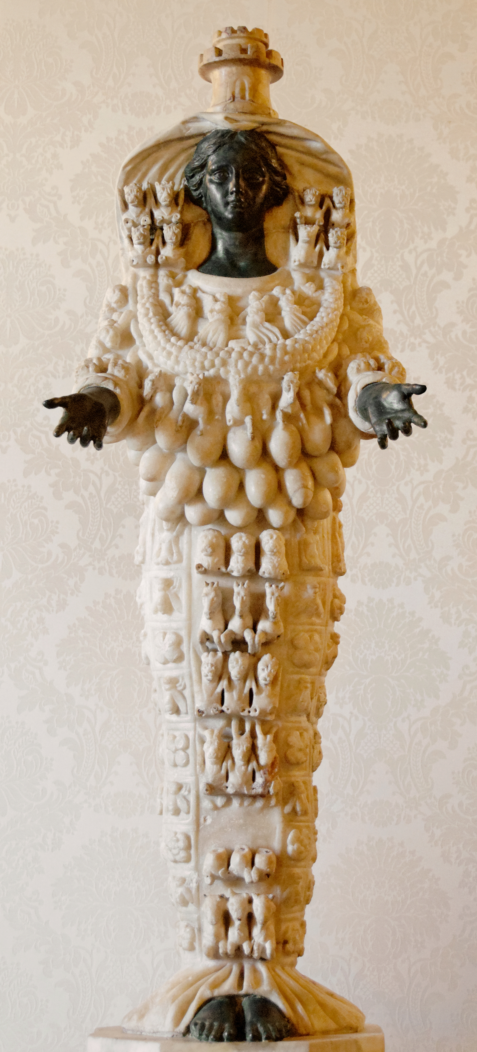
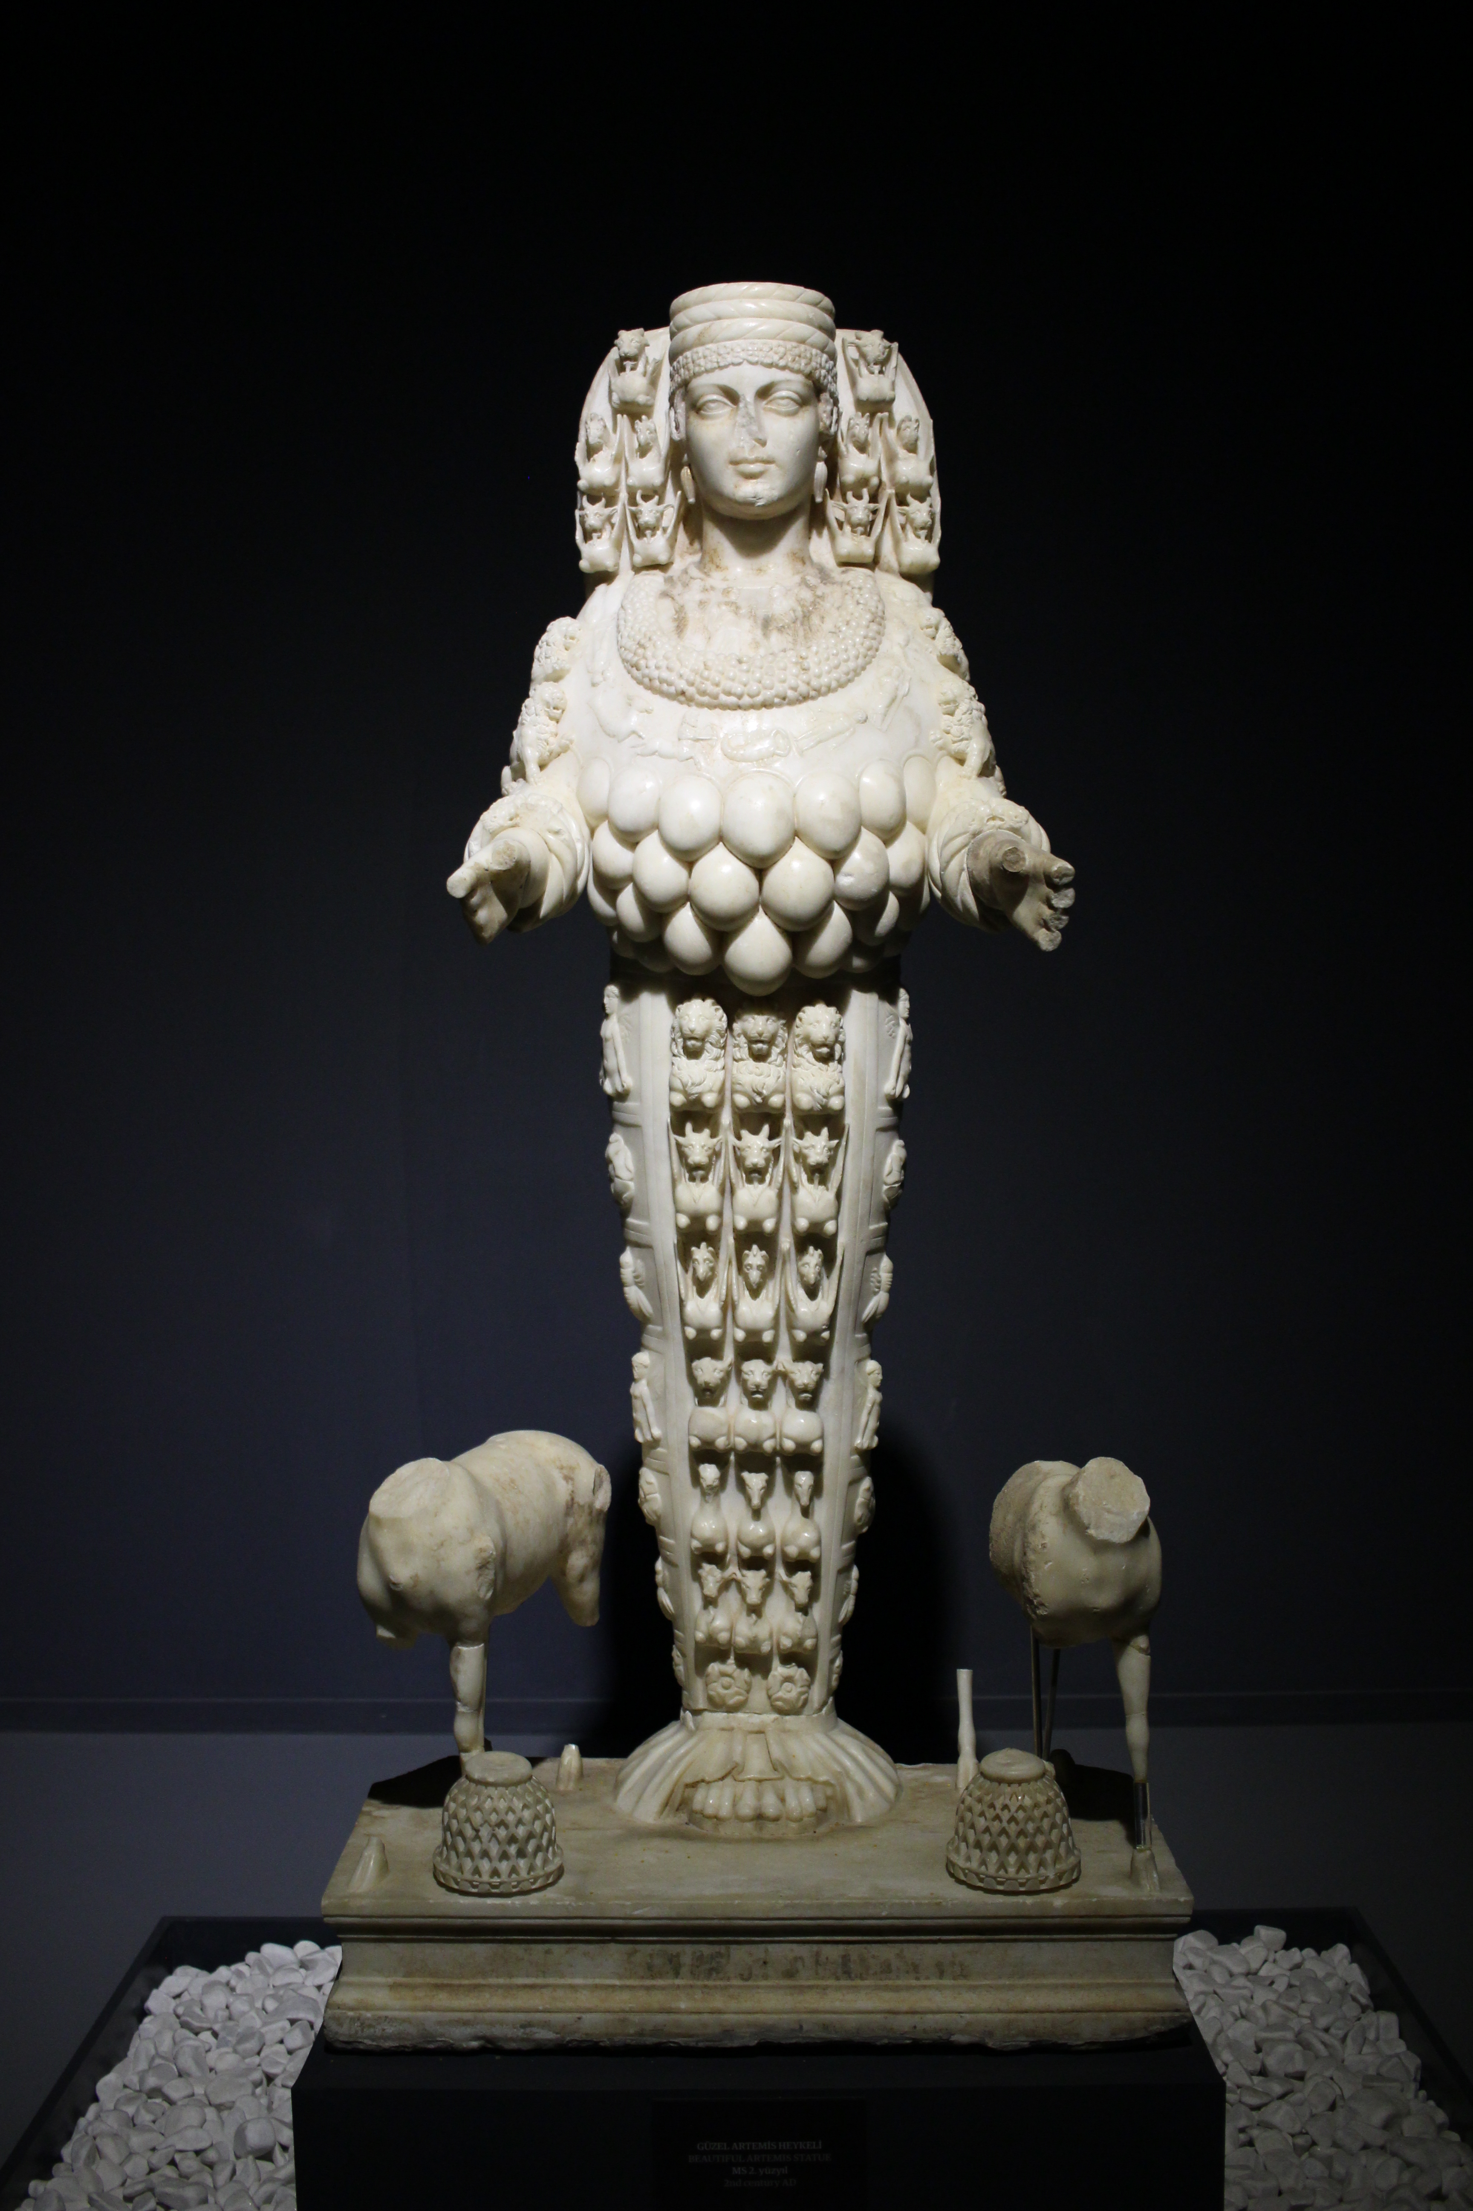
Notes:
Photographer: Blcksprt
https://commons.wikimedia.org/wiki/File:The_Artemis_of_Ephesus.jpg
https://commons.wikimedia.org/wiki/File:Artemis_Ephesus_Musei_Capitolini_MC1182.jpg

Slide 7
Notes:
Photographer: Della Perone
Sound: https://soundcloud.com/lykanthea/hive

Slide 8
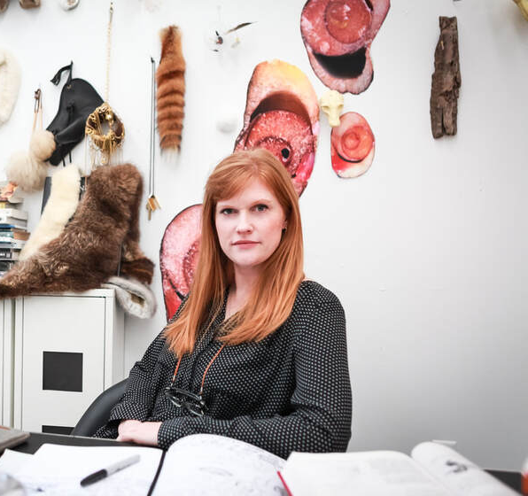
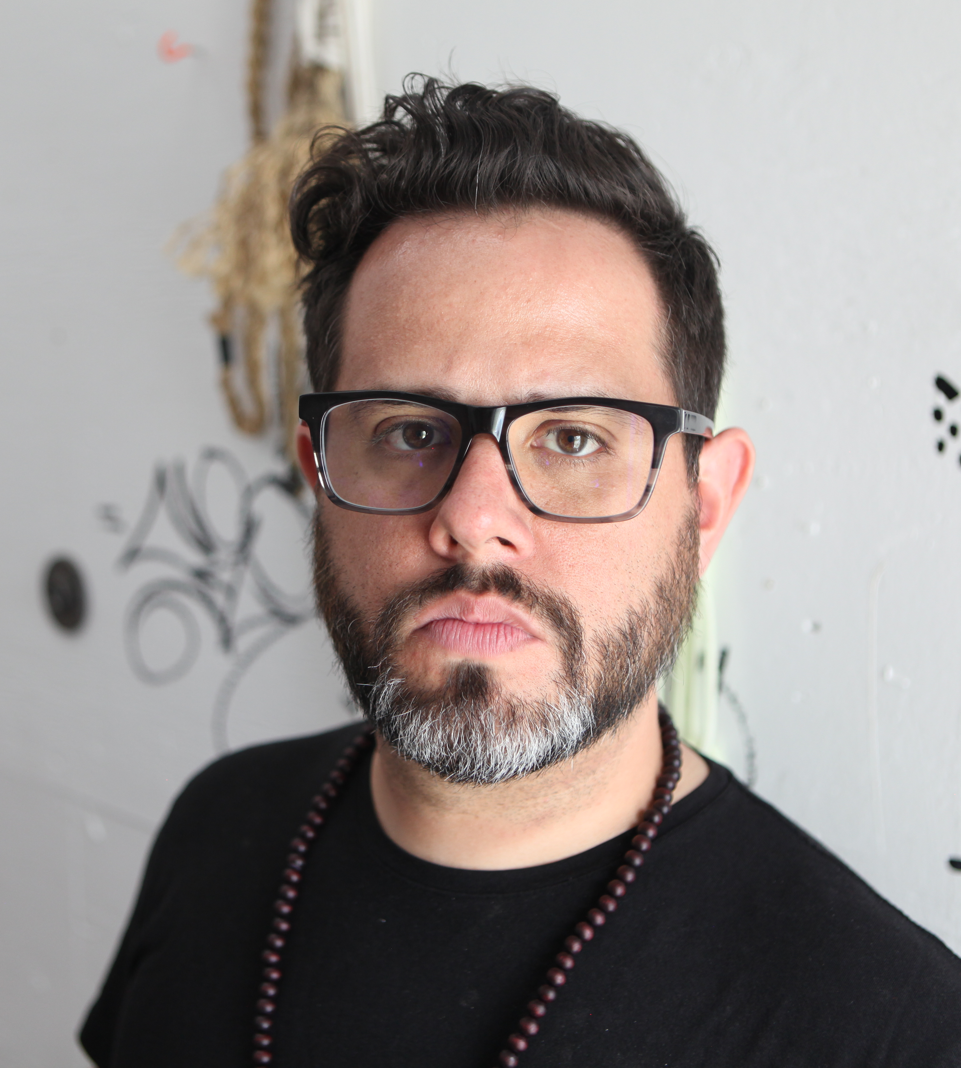

Slide 9
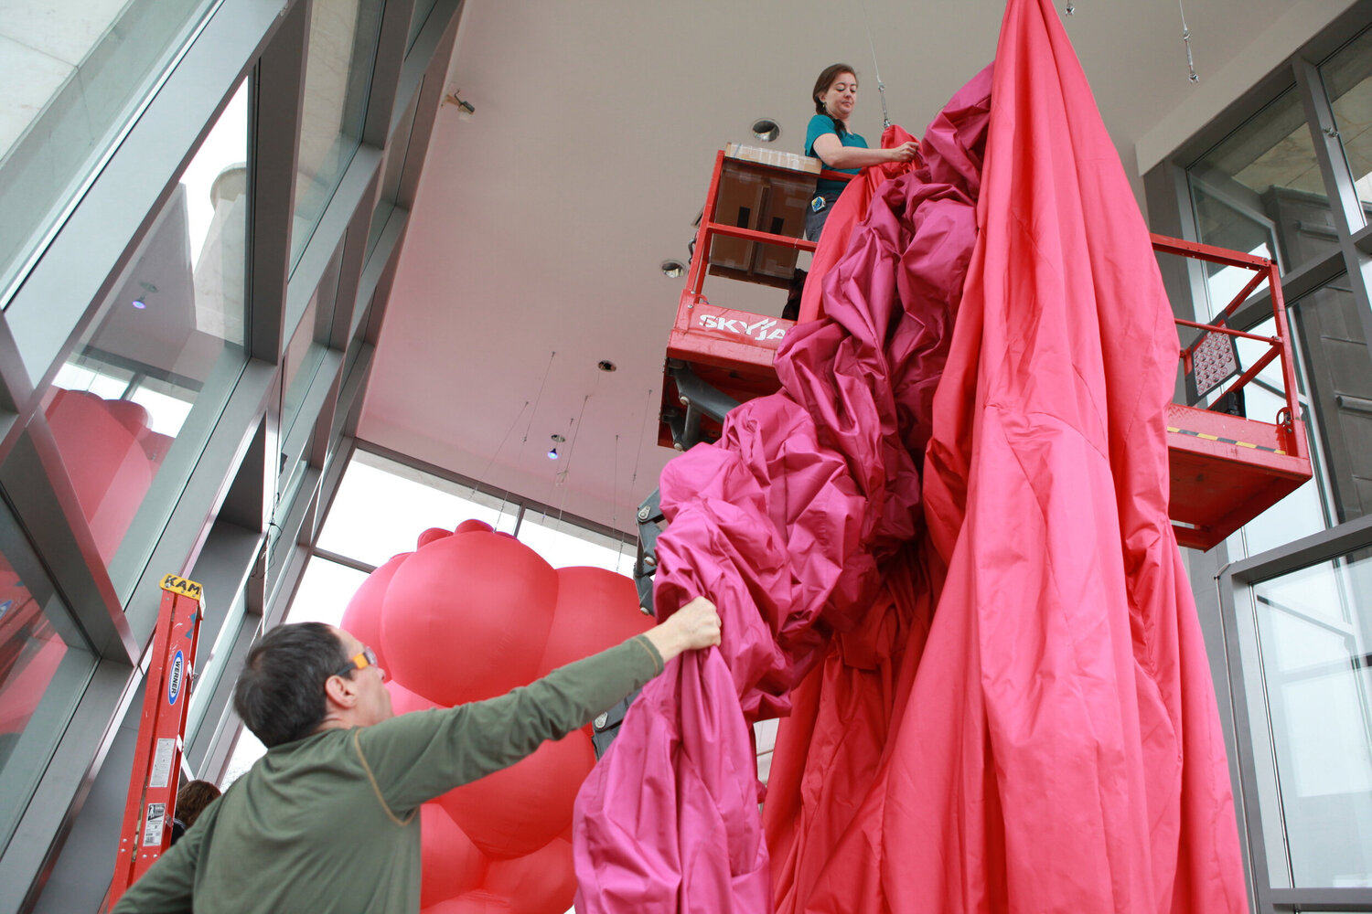
Notes:
Photographer: Stephen Signa-Aviles
http://www.nancydavidson.com/

Slide 10
Questions? Email Clara Bosak-Schroeder (cbosak@Illinois.edu)

